Slide 1
William Stallings
Computer Organization and Architecture
8th Edition
Chapter 11
Instruction Sets:
Addressing Modes and Formats

Slide 2
Addressing Modes
Immediate
Direct
Indirect
Register
Register Indirect
Displacement (Indexed)
Stack
Notes:
2

Slide 3
Immediate Addressing
Operand is part of instruction
Operand = address field
e.g. ADD 5
  Add 5 to contents of accumulator
  5 is operand
No memory reference to fetch data
Fast
Limited range
Notes:
3

Slide 4
Immediate Addressing Diagram
Instruction
Opcode
Operand
Notes:
4

Slide 5
Direct Addressing
Address field contains address of operand
Effective address (EA) = address field (A)
e.g. ADD A
  Add contents of cell A to accumulator
  Look in memory at address A for operand
Single memory reference to access data
No additional calculations to work out effective address
Limited address space
Notes:
5

Slide 6
Direct Addressing Diagram
Instruction
Opcode
Address A
Memory
Operand
Notes:
6

Slide 7
Indirect Addressing (1)
Memory cell pointed to by address field contains the address of (pointer to) the operand
EA = (A)
  Look in A, find address (A) and look there for operand
e.g. ADD (A)
  Add contents of cell pointed to by contents of A to accumulator
Notes:
7

Slide 8
Indirect Addressing (2)
Large address space
2^{n} where n = word length
May be nested, multilevel, cascaded
  e.g. EA = (((A)))
    Draw the diagram yourself
Multiple memory accesses to find operand
Hence slower
Notes:
8

Slide 9
Indirect Addressing Diagram
Instruction
Opcode
Address A
Memory
Pointer to operand
Operand
Notes:
9

Slide 10
Register Addressing (1)
Operand is held in register named in address filed
EA = R
Limited number of registers
Very small address field needed
  Shorter instructions
  Faster instruction fetch
Notes:
10

Slide 11
Register Addressing (2)
No memory access
Very fast execution
Very limited address space
Multiple registers helps performance
  Requires good assembly programming or compiler writing
  N.B. C programming
    register int a;
c.f. Direct addressing
Notes:
11

Slide 12
Register Addressing Diagram
Instruction
Opcode
Register Address R
Registers
Operand
Notes:
12

Slide 13
Register Indirect Addressing
C.f. indirect addressing
EA = (R)
Operand is in memory cell pointed to by contents of register R
Large address space (2^{n})
One fewer memory access than indirect addressing
Notes:
13

Slide 14
Register Indirect Addressing Diagram
Instruction
Opcode
Register Address R
Memory
Registers
Pointer to Operand
Operand
Notes:
14

Slide 15
Displacement Addressing
EA = A + (R)
Address field hold two values
  A = base value
  R = register that holds displacement
  or vice versa
Notes:
15

Slide 16
Displacement Addressing Diagram
Instruction
Opcode
Register R
Address A
Memory
Registers
Pointer to Operand
+
Operand
Notes:
16

Slide 17
Relative Addressing
A version of displacement addressing
R = Program counter, PC
EA = A + (PC)
i.e. get operand from A cells from current location pointed to by PC
c.f locality of reference & cache usage
Notes:
17

Slide 18
Base-Register Addressing
A holds displacement
R holds pointer to base address
R may be explicit or implicit
e.g. segment registers in 80x86
Notes:
18

Slide 19
Indexed Addressing
A = base
R = displacement
EA = A + R
Good for accessing arrays
  EA = A + R
  R++
Notes:
19

Slide 20
Combinations
Postindex
EA = (A) + (R)
Preindex
EA = (A+(R))
(Draw the diagrams)
Notes:
20

Slide 21
Stack Addressing
Operand is (implicitly) on top of stack
e.g.
  ADD Pop top two items from stack and add
Notes:
21

Slide 22
x86 Addressing Modes
Virtual or effective address is offset into segment
  Starting address plus offset gives linear address
  This goes through page translation if paging enabled
12 addressing modes available
  Immediate
  Register operand
  Displacement
  Base
  Base with displacement
  Scaled index with displacement
  Base with index and displacement
  Base scaled index with displacement
  Relative

Slide 23
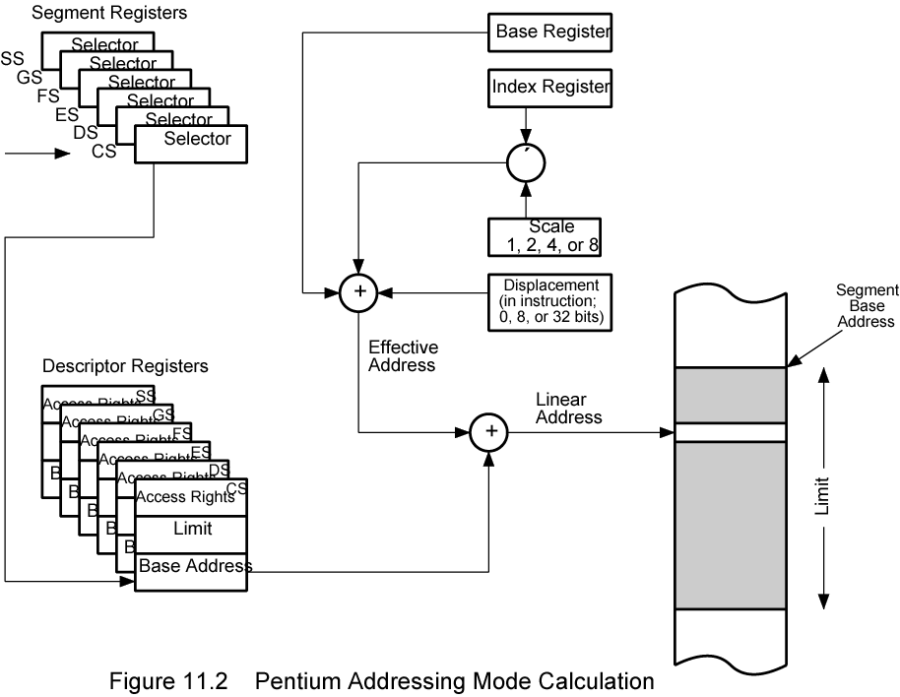
x86 Addressing Mode Calculation

Slide 24
ARM Addressing Modes
Load/Store
Only instructions that reference memory
Indirectly through base register plus offset
Offset
  Offset added to or subtracted from base register contents to form the memory address
Preindex
  Memory address is formed as for offset addressing
  Memory address also written back to base register
  So base register value incremented or decremented by offset value
Postindex
  Memory address is base register value
  Offset added or subtracted
  Result written back to base register
Base register acts as index register for preindex and postindex addressing
Offset either immediate value in instruction or another register
If register scaled register addressing available
  Offset register value scaled by shift operator
  Instruction specifies shift size

Slide 25
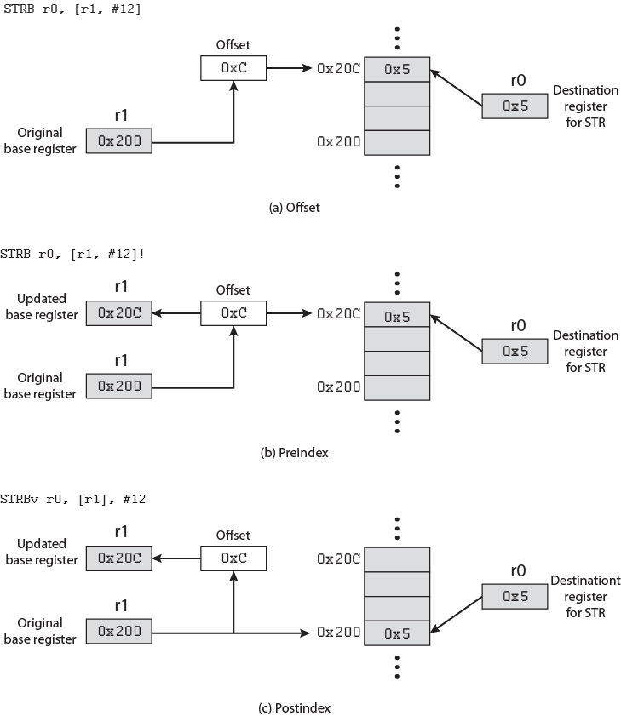
ARM
Indexing
Methods

Slide 26
ARM Data Processing Instruction Addressing
& Branch Instructions
Data Processing
  Register addressing
    Value in register operands may be scaled using a shift operator
  Or mixture of register and immediate addressing
Branch
  Immediate
  Instruction contains 24 bit value
  Shifted 2 bits left
    On word boundary
    Effective range +/-32MB from PC.

Slide 27
ARM Load/Store Multiple Addressing
Load/store subset of general-purpose registers
16-bit instruction field specifies list of registers
Sequential range of memory addresses
Increment after, increment before, decrement after, and decrement before
Base register specifies main memory address
Incrementing or decrementing starts before or after first memory access

Slide 28
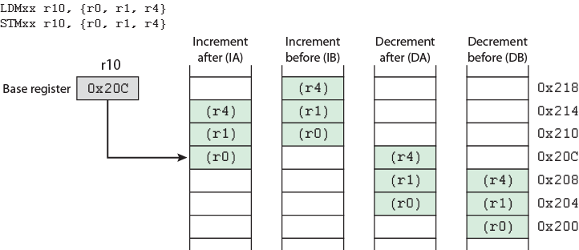
ARM Load/Store Multiple Addressing Diagram

Slide 29
Instruction Formats
Layout of bits in an instruction
Includes opcode
Includes (implicit or explicit) operand(s)
Usually more than one instruction format in an instruction set

Slide 30
Instruction Length
Affected by and affects:
  Memory size
  Memory organization
  Bus structure
  CPU complexity
  CPU speed
Trade off between powerful instruction repertoire and saving space

Slide 31
Allocation of Bits
Number of addressing modes
Number of operands
Register versus memory
Number of register sets
Address range
Address granularity

Slide 32
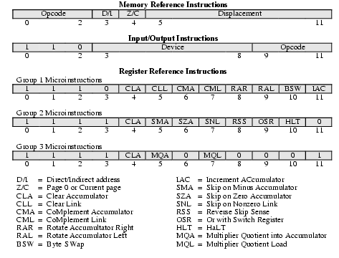
PDP-8 Instruction Format

Slide 33
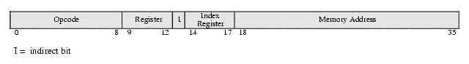
PDP-10 Instruction Format

Slide 34
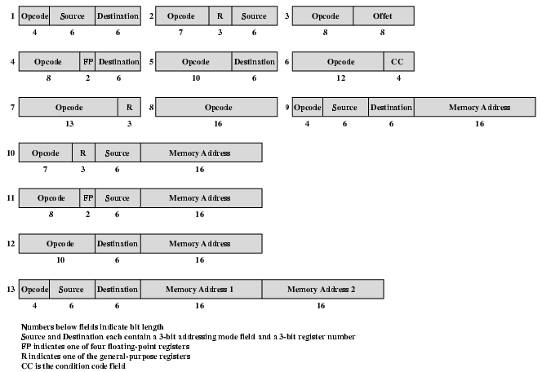
PDP-11 Instruction Format

Slide 35
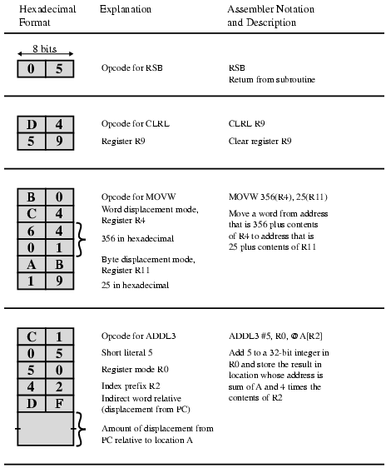
VAX Instruction Examples

Slide 36
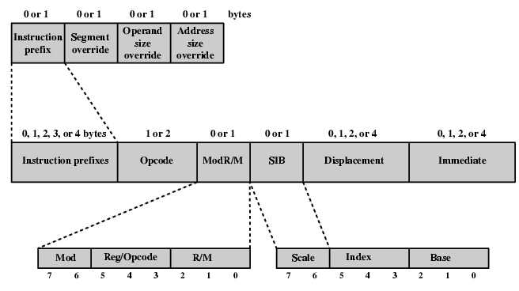
x86 Instruction Format

Slide 37
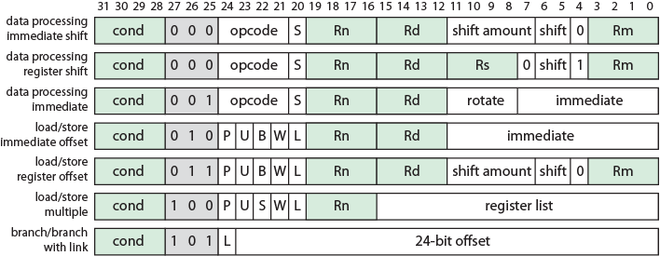
ARM Instruction Formats
S = For data processing instructions, updates condition codes
S = For load/store multiple instructions, execution restricted to supervisor mode
P, U, W = distinguish between different types of addressing_mode
B = Unsigned byte (B==1) or word (B==0) access
L = For load/store instructions, Load (L==1) or Store (L==0)
L = For branch instructions, is return address stored in link register

Slide 38
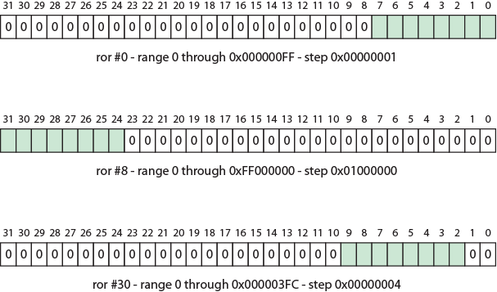
ARM Immediate Constants Fig 11.11

Slide 39
Thumb Instruction Set
Re-encoded subset of ARM instruction set
Increases performance in 16-bit or less data bus
Unconditional (4 bits saved)
Always update conditional flags
  Update flag not used (1 bit saved)
Subset of instructions
  2 bit opcode, 3 bit type field (1 bit saved)
  Reduced operand specifications (9 bits saved)

Slide 40
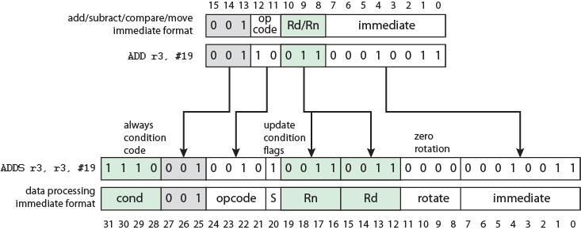
Expanding Thumb ADD Instruction to ARM Equivalent Fig 11.12

Slide 41
Assembler
Machines store and understand binary instructions
E.g. N= I + J + K initialize I=2, J=3, K=4
Program starts in location 101
Data starting 201
Code:
Load contents of 201 into AC
Add contents of 202 to AC
Add contents of 203 to AC
Store contents of AC to 204
Tedious and error prone

Slide 42
Improvements
Use hexadecimal rather than binary
  Code as series of lines
    Hex address and memory address
  Need to translate automatically using program
Add symbolic names or mnemonics for instructions
Three fields per line
  Location address
  Three letter opcode
  If memory reference: address
Need more complex translation program

Slide 43
Program in:
Binary Hexadecimal
Address | Contents |  |  |  |  | Address | Contents
101 | 0010 | 0010 | 101 | 2201 |  | 101 | 2201
102 | 0001 | 0010 | 102 | 1202 |  | 102 | 1202
103 | 0001 | 0010 | 103 | 1203 |  | 103 | 1203
104 | 0011 | 0010 | 104 | 3204 |  | 104 | 3204
201 | 0000 | 0000 | 201 | 0002 |  | 201 | 0002
202 | 0000 | 0000 | 202 | 0003 |  | 202 | 0003
203 | 0000 | 0000 | 203 | 0004 |  | 203 | 0004
204 | 0000 | 0000 | 204 | 0000 |  | 204 | 0000

Slide 44
Symbolic Addresses
First field (address) now symbolic
Memory references in third field now symbolic
Now have assembly language and need an assembler to translate
Assembler used for some systems programming
  Compliers
  I/O routines

Slide 45
Symbolic Program
Address | Instruction
101 | LDA | 201
102 | ADD | 202
103 | ADD | 203
104 | STA | 204
201 | DAT | 2
202 | DAT | 3
203 | DAT | 4
204 | DAT | 0

Slide 46
Assembler Program
Label | Operation | Operand
FORMUL | LDA | I
 | ADD | J
 | ADD | K
 | STA | N
I | DATA | 2
J | DATA | 3
K | DATA | 4
N | DATA | 0

Slide 47
Foreground Reading
Stallings chapter 11
Intel and ARM Web sites

